Slide 1
System prototype screen designs
By Bright PHIRI

Slide 2
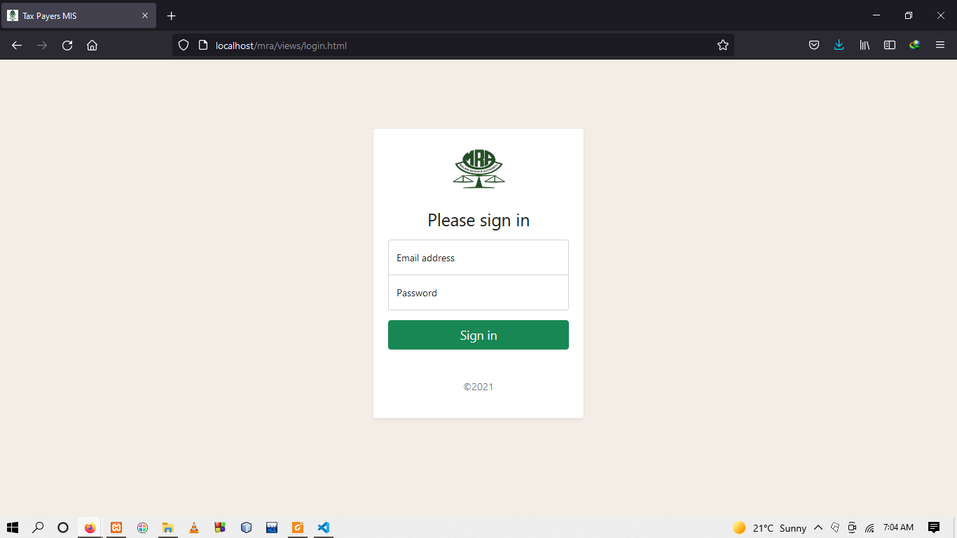
Field Officer Login Page

Slide 3
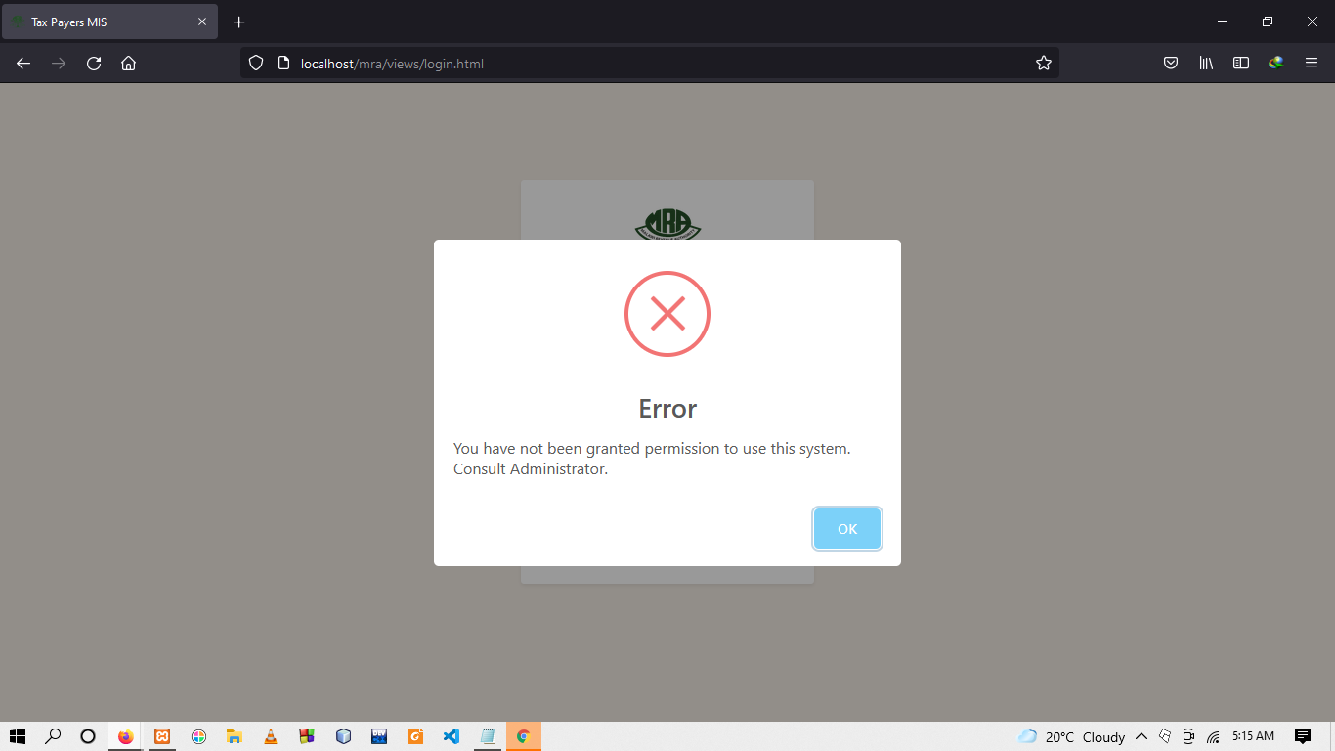
Conti..

Slide 4
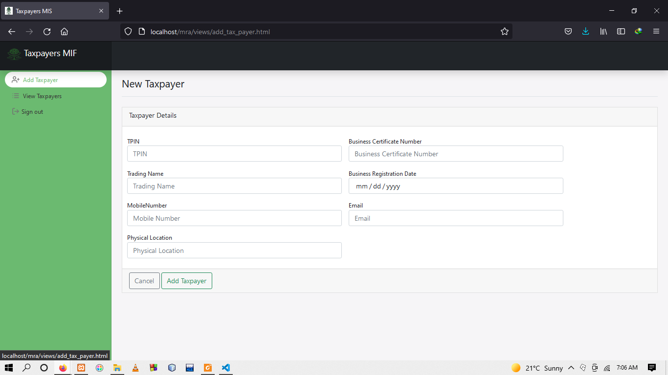
Taxpayers Registration Page

Slide 5
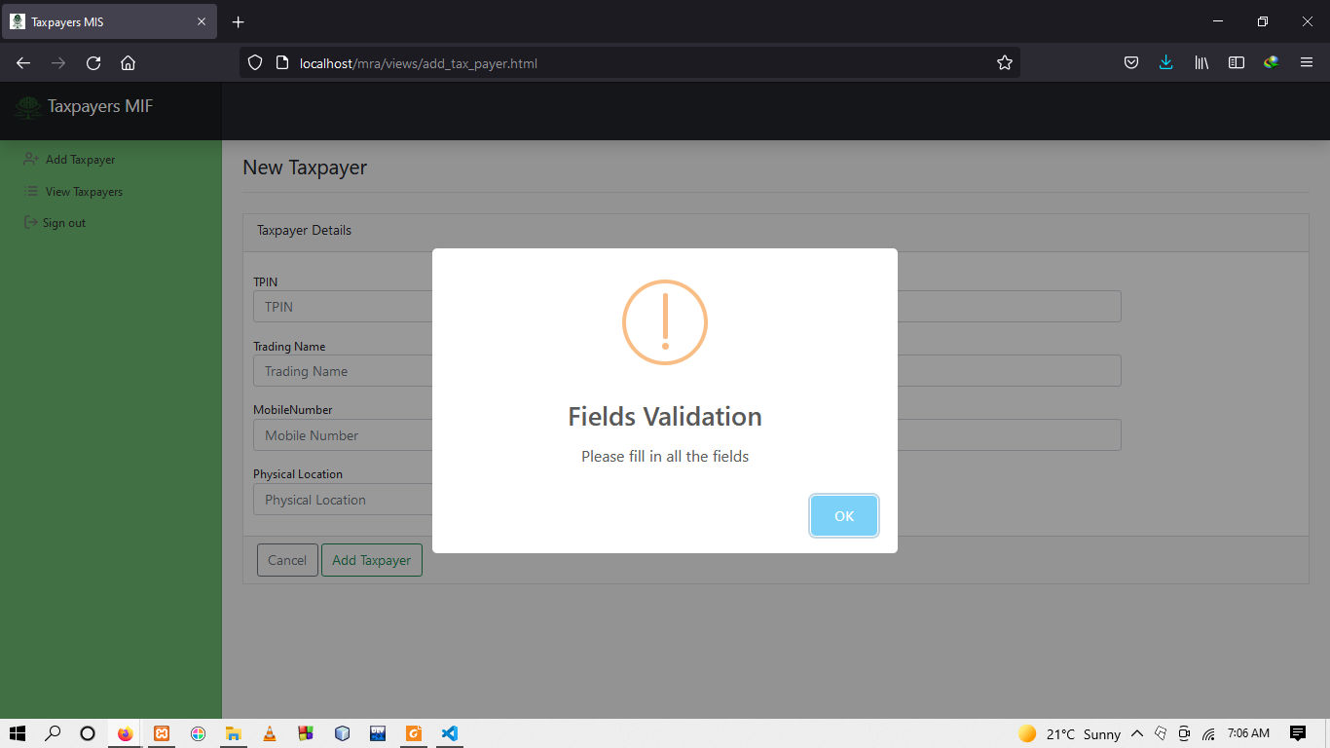
Conti..

Slide 6
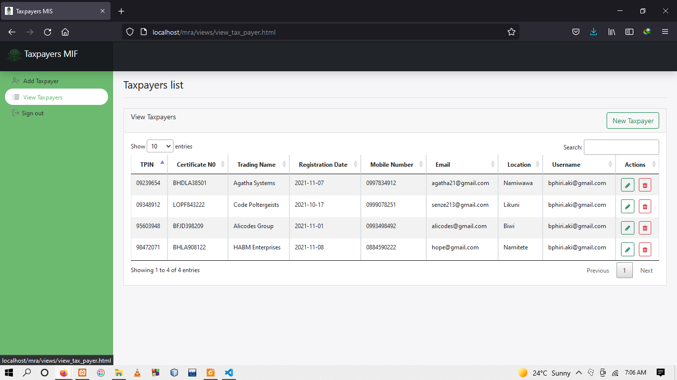
All Taxpayers page

Slide 7
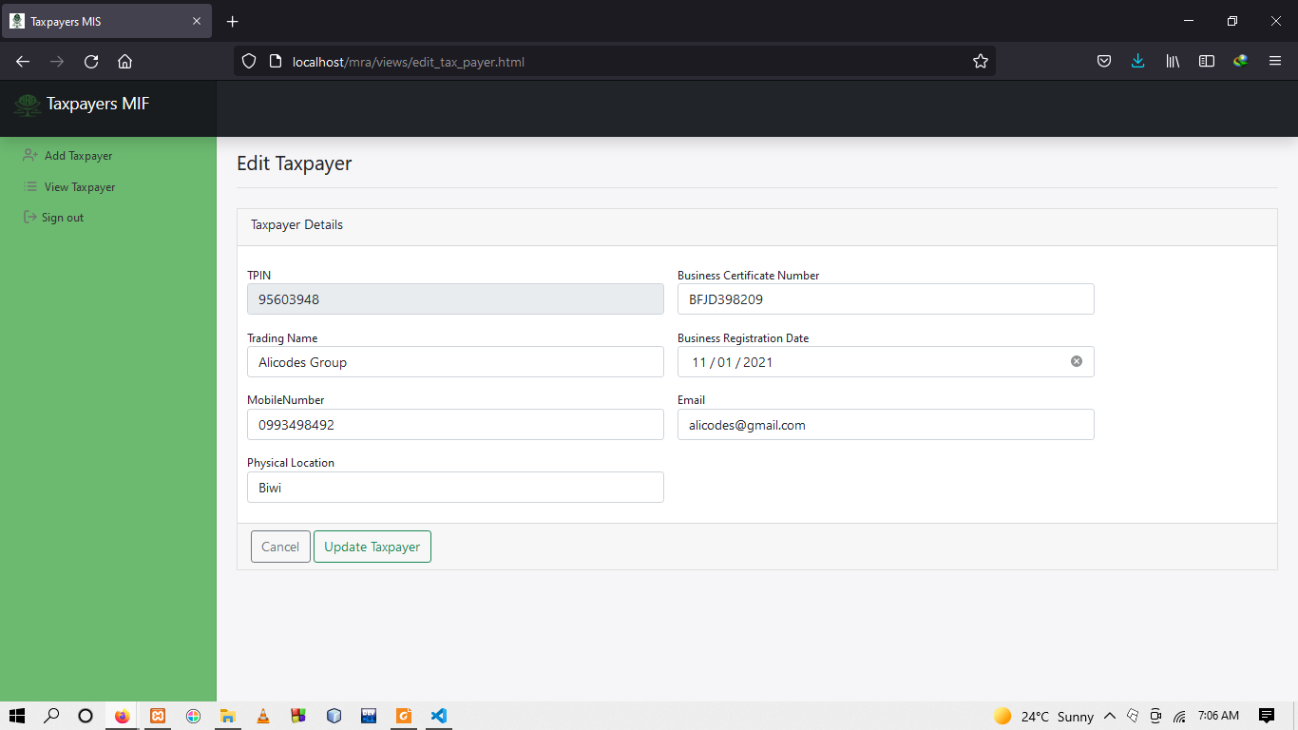
Taxpayer edit and update page

Slide 8
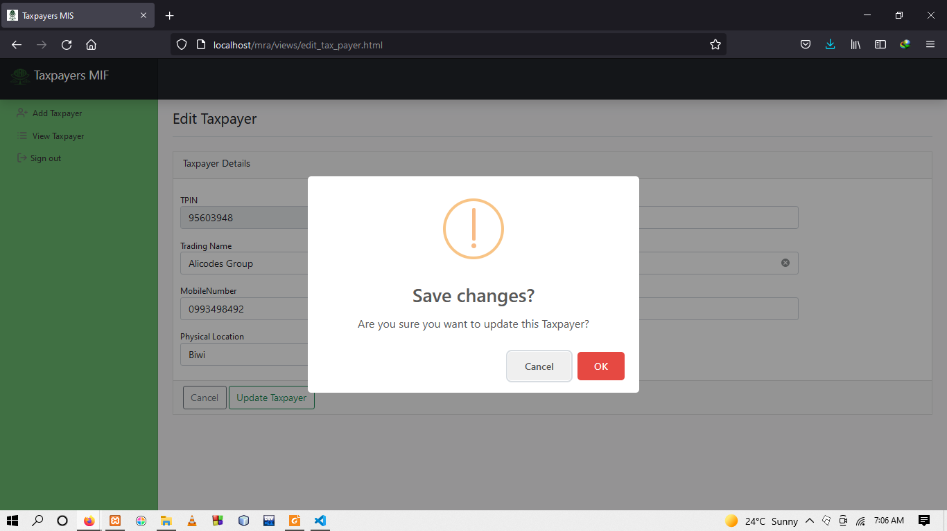
Conti..

Slide 9
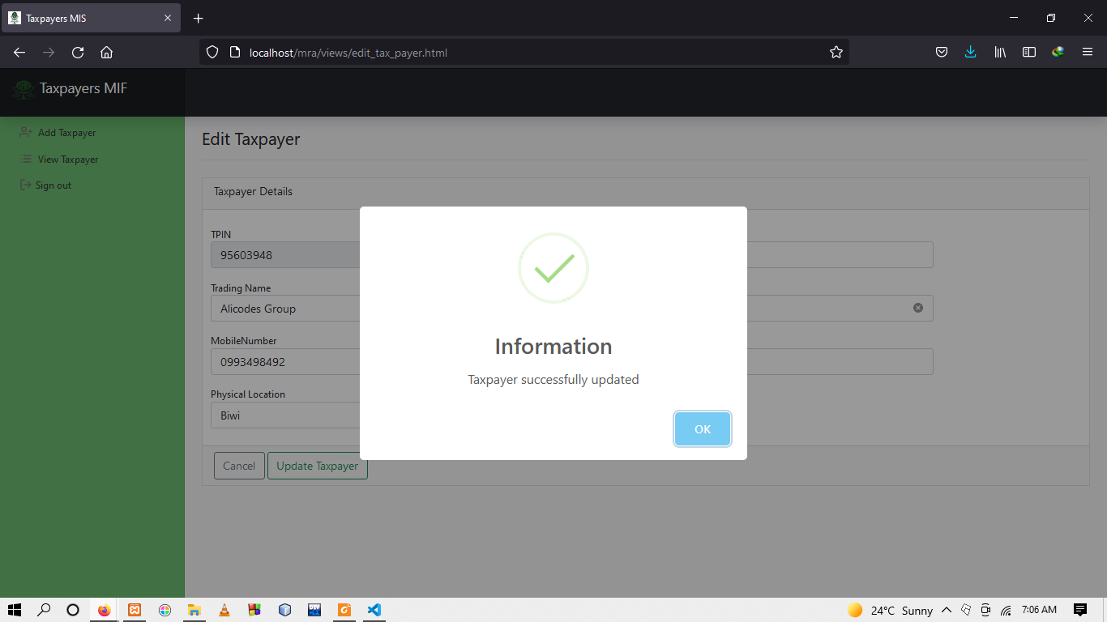
Conti..

Slide 10
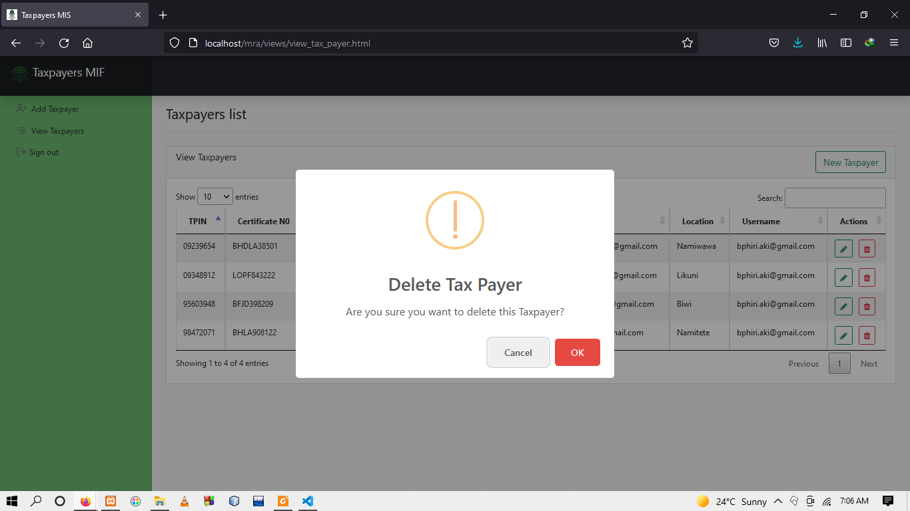
Taxpayer selection and delete page

Slide 11
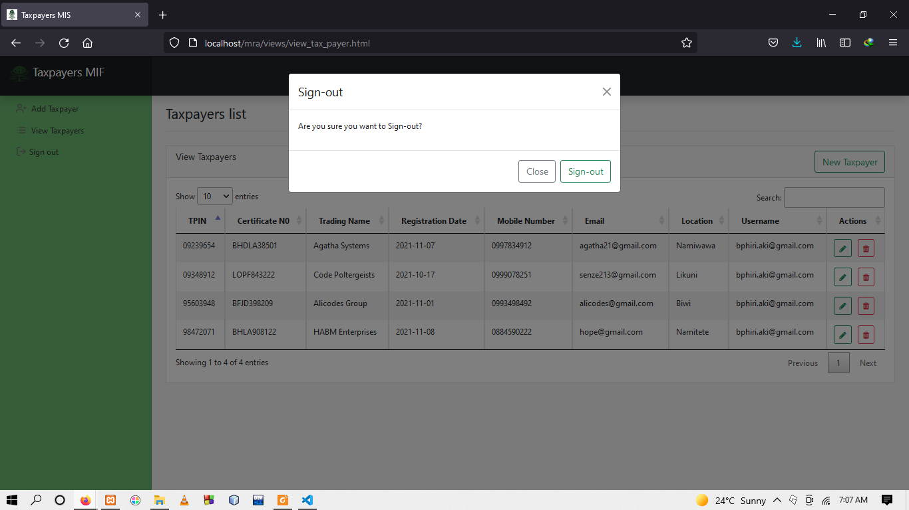
Field Officer Logout

